Slide 1
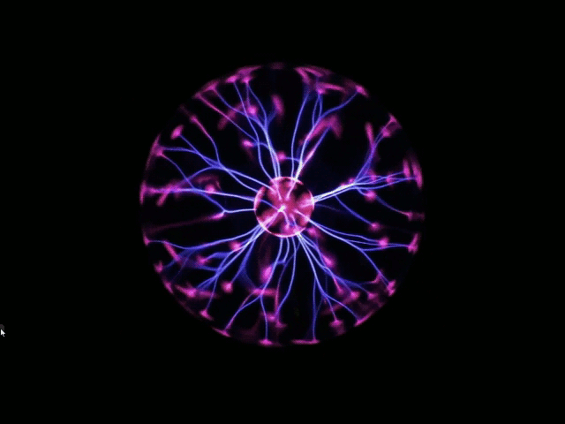
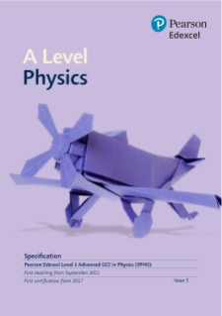
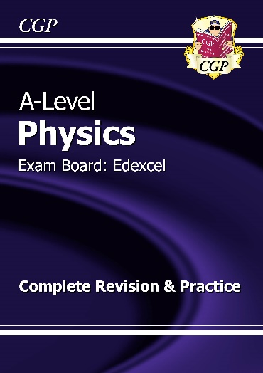
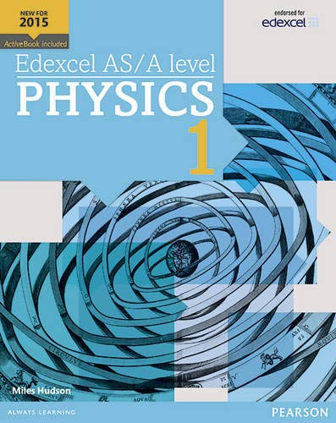
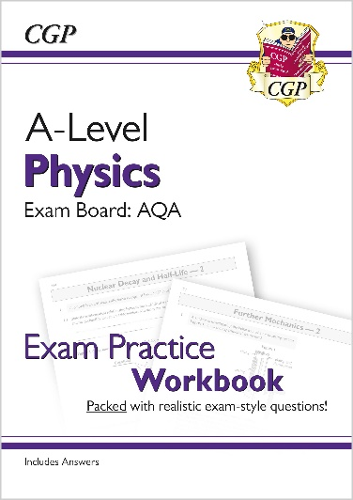
A Level Physics
Mr McConville, Mr McAleese, Mrs Bayford
Physics is increasingly popular at Angmering and is a key subject for lots of STEM careers; particularly in engineering, architecture and design, medicine, careers in the energy sector, the aeronautical and automotive industries, electronics and many more.
At Angmering we follow the EDEXCEL Concept led approach, through which you will cover topics about mechanics and dynamics, electrical circuits, materials and fluids dynamics, waves and the particle nature of light, magnetic and electrical fields, nuclear physics, quantum physics, astrophysics and cosmology, across the 2 year course.
In addition to the curriculum content, there is also a strong focus on practical work, problem solving and the application of mathematical and analytical skills to investigate and draw conclusions about the physical universe; these are transferrable skills and as such are highly valued in other fields such as business and finance.
Entry Criteria for A Level Physics:
Grade 6 or above in Science or Physics
Grade 6 or above in Maths
Resources:
All students are provided with a long term loan text book, and revision guides and work books are sold at discount via Parent Pay.
Teaching:
Students in Year 12 receive 9 hours per fortnight of direct instruction and are expected to complete 4 hours of independent learning. In Year 13 students receive 8 hours per fortnight of direct instruction and are expected to work and revise independently for a minimum of 4 hours per week.
Lessons include theory and practical work and cover the skills required to pass the Assessed Practical element of the course.

