Slide 1


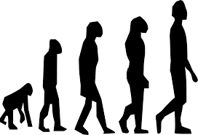
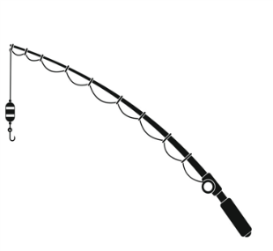
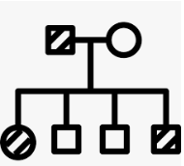
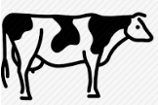
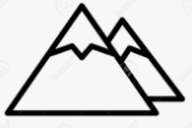






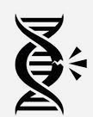
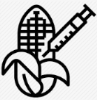

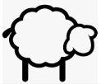

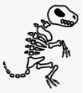






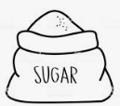
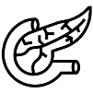











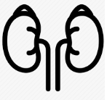


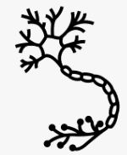
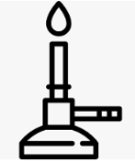
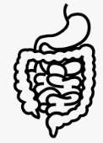
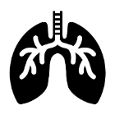


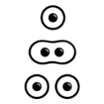






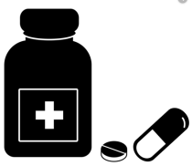


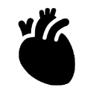



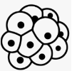

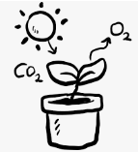





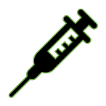


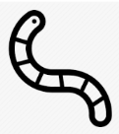





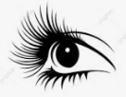

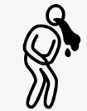


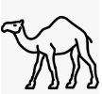


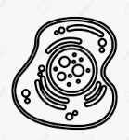

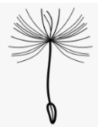




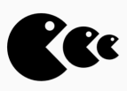
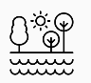
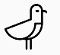
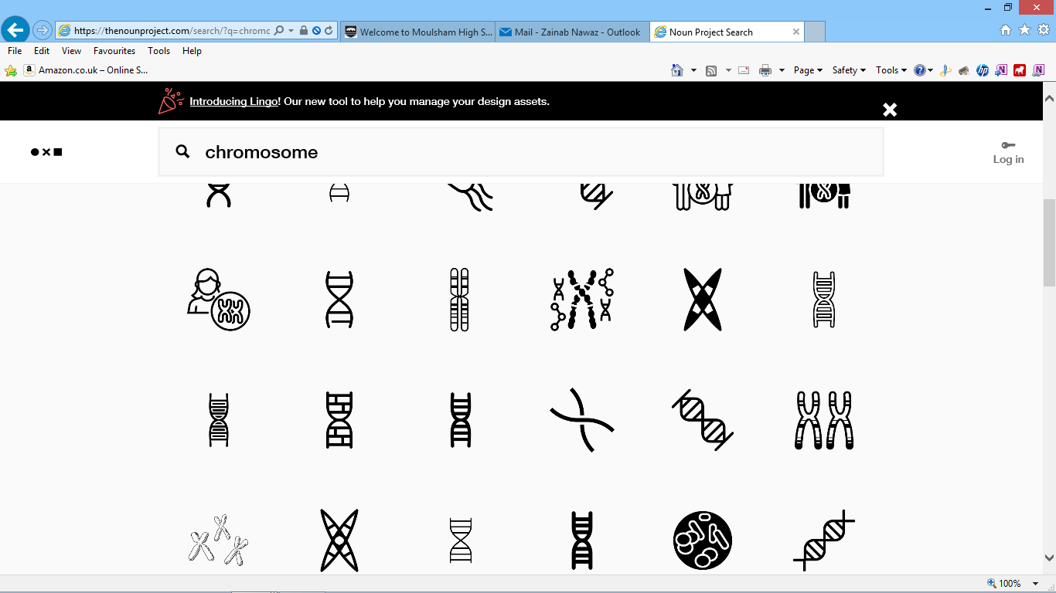


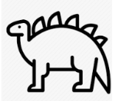



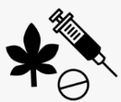











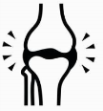
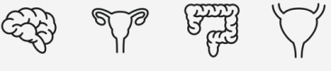





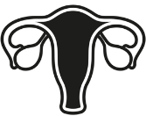
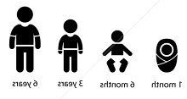
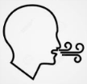


Biology Learning Journey
Year 7
Understanding and Applying Scientific Skills
Year 11
Writing methods
Assessing impact of scientific concepts
Understanding relationships between science and society
IDEAL
Identify, describe, explain, apply, link
Risk Assessment
Understanding variables
Drawing graphs and analysing graphical data
Analysis of secondary data
Modelling scientific concepts
Drawing conclusions
Applying maths to the scientific concepts
Describe patters
Variation
Selective breeding
Ethics of genetic engineering
Theories of evolution- Darwin
Speciation
Antibiotic resistant bacteria
Farming techniques
Sustainable fishing
Genetic inheritance
Variation, genetics and evolution
Classification
Trophic level
Exam & Post – 16
Destination
Sex inheritance
Food Production
Asexual reproduction
Evolution by natural selection
Genetic engineering
Cloning
Fossils
Evidence for evolution
Transfer of Biomass
Factors affecting food security
Gene expression and mutations
Protein synthesis
Adult cell Cloning
History of genetics
Sustainable food production
Sexual and
DNA structure
DNA and the genome
Meiosis
Sexual and asexual reproduction
11
IVF
Diabetes
Controlling blood glucose
Thermoregulation
The Brain
Reflex action
Homeostasis
YEAR
Hormonal control
Homeostasis and The nervous system
Response to exercise
Contraception
Menstrual cycle
Endocrine system
Problems with the eye
Structure of the eye
Structure and function of the nervous system
Respiration
Metabolism
Anaerobic respiration
Aerobic respiration
Digestive system
Breathing and gas exchange
Health and disease
Active Transport
Effect of Light on Photosynthesis
Making the most of photosynthesis
YEAR
Blood
Cancer
Mitosis
Sterile technique
10
Tissues, organs and organ systems
Diffusion
Photosynthesis
Cell division and transport
Uses of Glucose
Discovery and development of drugs
Antibiotics and Painkillers
Food tests
The heart
Blood vessels
Non communicable disease
Chromosomes
Stem cells
Osmosis
Photosynthesis reaction
Rate of photosynthesis
Disease
Vaccinations
Fungal and protist diseases
Human defence systems
Viral diseases
Water cycle
Decomposition
Predator prey
Sampling techniques
Adaptations for hot and cold environments
Abiotic and Biotic factors
Plant organ systems
Organisation hierachy
Microscopy
Ecology
Cell differentiation
Bacterial disease
Random Sampling- Quadrats and Transects
Cells
Prokaryotes and Eukaryotes
Disease
Carbon cycle
Food chains
Distribution of organisms
Adaptations
Communities
Transpiration
Plant tissues
Specialised cells
Plant and animal cells
YEAR
9
Food tests
Unhealthy diet
Digestive system
Plant minerals
Aerobic Respiration
Food chains and webs
Natural selection
Alcohol
Leaves
Ecosystems
Variation
Inheritance
YEAR
Health and Lifestyle
Ecosystem processes
Adaptation and Inheritance
8
Extinction
Drugs
Competition and Adaptation
Continuous and discontinuous variation
Nutrients
Bacteria and enzymes in digestion
Smoking
Photosynthesis
Chemosynthesis
Anaerobic Respiration
Disruption to food chains and webs
Adapting to change
Seed dispersal
Flowers and pollination
Reproduction
The menstrual cycle?
Fertilisation and implantation
Movement: joints
Skeleton
Levels of organisation
Movement of substances
Specialised cells
Observing cells
YEAR
Fertilisation and germination
Body systems
Cells
7
Development of a fetus
Reproductive systems
Adolescence
Movement: Muscles
Breathing
Gas exchange
Cell division
Unicellular organisms
Plant and animal cells

