Slide 1


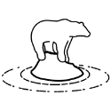













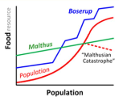






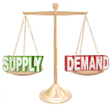







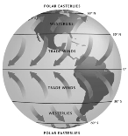








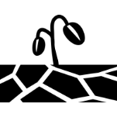
























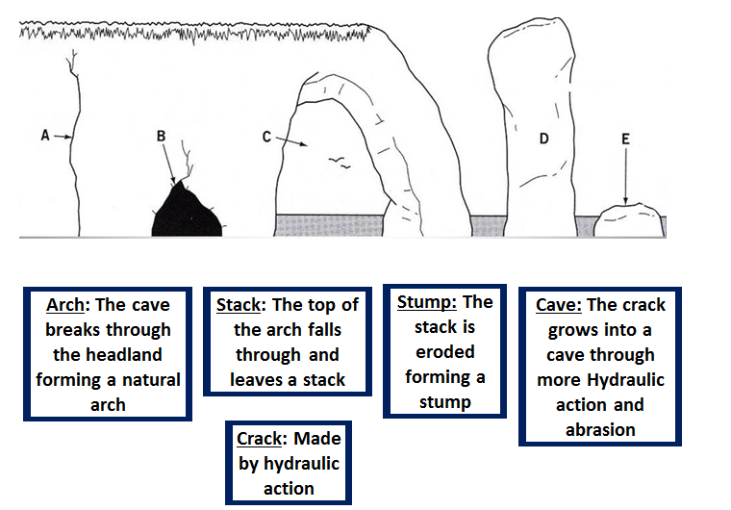






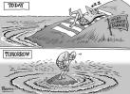

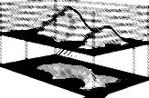
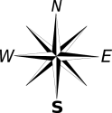



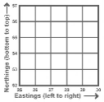
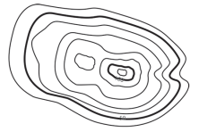

Geography Learning Journey
Year 7
Understanding and Applying Geography Skills
Year 11
Location
Inference
Numerical
GIS
Statistical
Evidence
Fieldwork
Cartographic
Graphical
Evaluative
Conclusive
Analytical
Sustainability
Investigatory
Data processing
Argumentative
Data presentation
Revision techniques
National Food Security
Natural
Climate
Change
Global
Impacts
Environmental Impacts
UK Wine Industry
Distinctive Landscapes
Final Exams
Climate Change
Revision
Exam & Post – 16
Destination
Tanzania
Goat Aid
Human
Climate Change
UK Impacts
Responses to Climate Change
UK in the 21st Century
Fieldwork
Skills
Malthus & Bosrup
Resource Reliance
Food Security
11
Physical Fieldwork
Coastal Landscapes
River
Processes
Mexico City’s Challenges
London’s Challenges
World vs Megacities
YEAR
Distinctive Landscapes
Urban Futures
Demand Vs Supply
Littlehampton West beach
River
Arun
Urban Trends
UK
Landscapes
Urbanisation
Plat
Boundaries
Global
Circulation
System
Impacts on Development
Water Aid
Development
Strategies
YEAR
Typhoon Haiyan
Zambia’s Development
UK Media
10
Global Hazards
Dynamic Development
Century
Millennium Development
Goals
Global Conflict
Nepal Earthquake
El Nino
UK Drought
Trade & Debt
UK Culture
the 21st
Economic
Hubs
Ageing
Population
Fairtrade
Apple (TNC)
Aid in Zambia
Tsunamis
UK in
Dynamic Development
Earthquakes
Employment
UK Geography
Trading Trainers Game
Sustainability
Industry
Measuring Development
Volcanoes
Global Hazards
Geology
Plate Tectonics
YEAR
River Processes
9
Flooding
Coastal Processes
Migration
London
Slums
Ecosystems
Weather
YEAR
Distinctive Landscapes
Urban Futures
Ecosystems
8
Microclimates
Solar Panel Investigation
Glaciation
Coastal Landforms
Megacities
Sustainable Cities
Biomes
Rainforests
Goat
Aid
Food
Security
Resource Reliance
Sea level
Rise
Ice Age
Relief
Direction
Renewable
Energy
YEAR
Climate Change
Map Skills
Intro To Geography
7
Energy Consumption
Greenhouse
gases
Grid
References
Contours
Symbols

