Slide 1
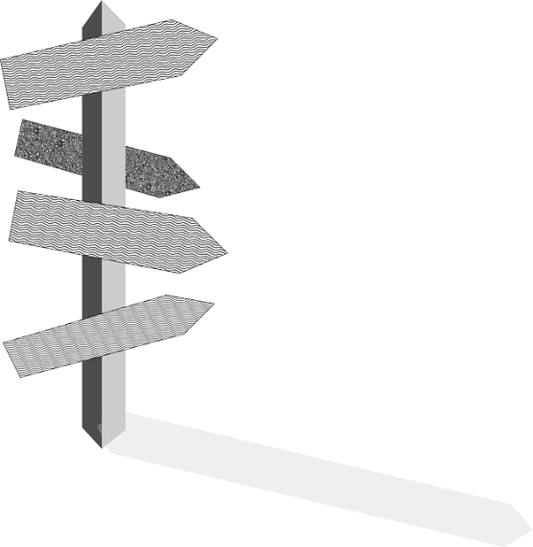
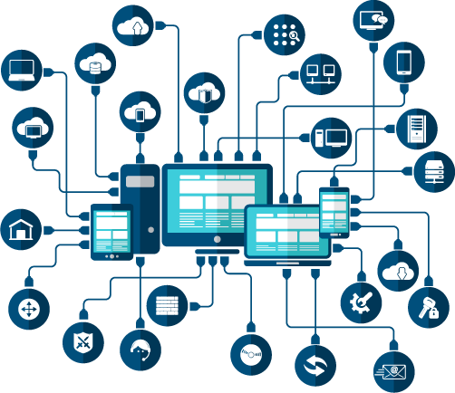
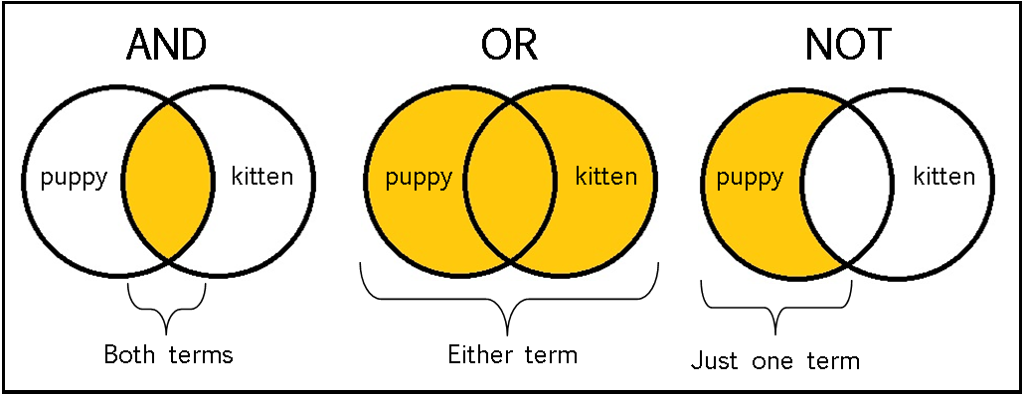
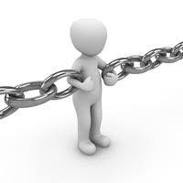
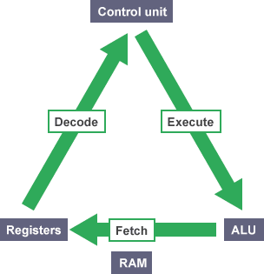
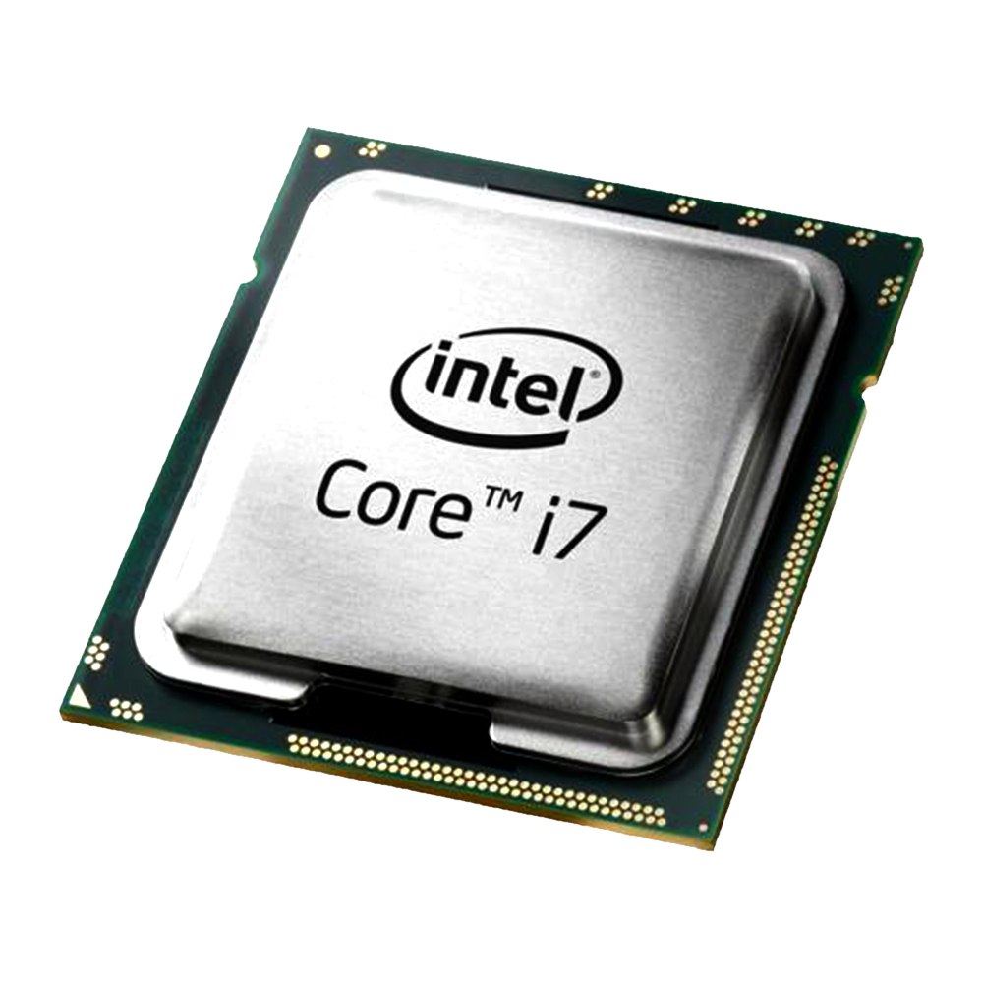
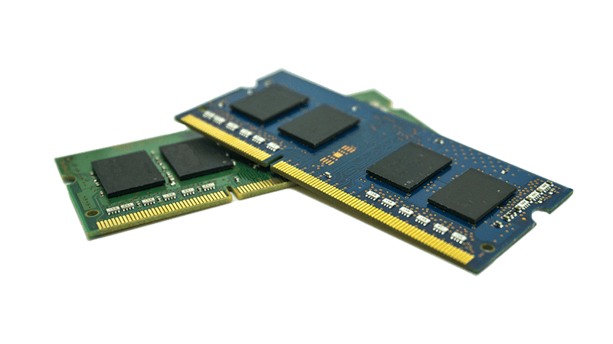
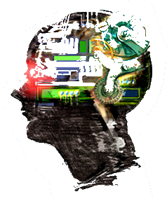
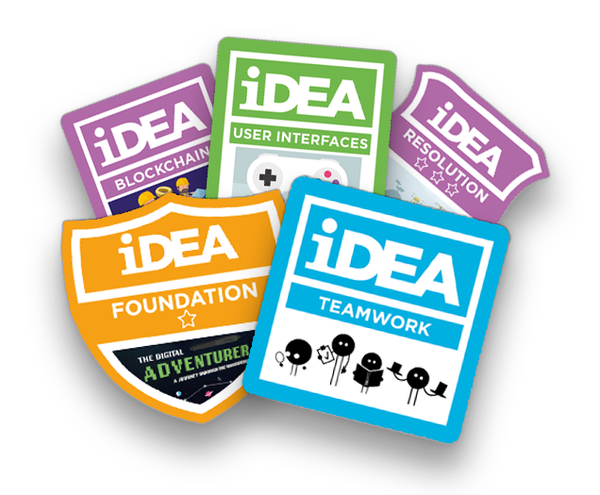
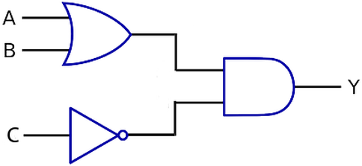
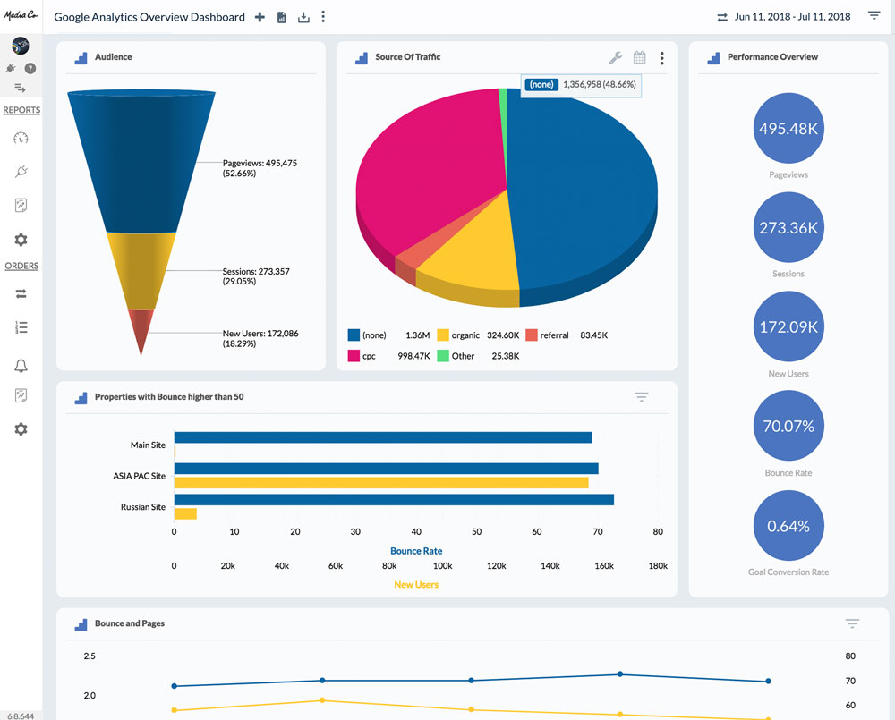
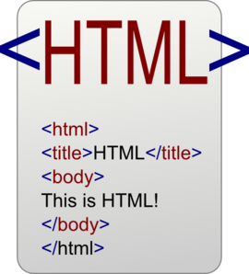
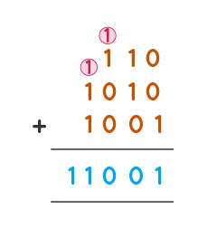
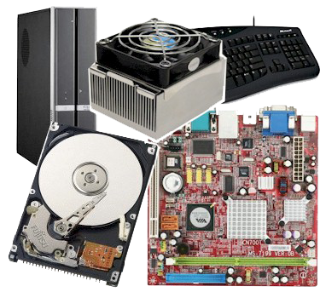
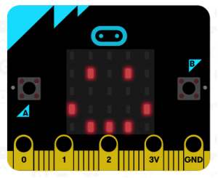
Computing
Learning Journey
E-Safety
Digital Literacy
IT Skills
Computational Skills
Programming
Literacy
Critical thinking
Independence
Key Stage 3
Key Stage 4
Key Stage 5
Utility Software
System Software
Summer exhibition
Post-16
destination
A-levels
BTEC
Apprenticeship
University and/or
career in technical
industries
Software
Examinations
Programming Project
Lasts ten weeks
Independent Programming
Network Security
YEAR
Security Techniques
Networks, connections & protocols
Producing Robust Programs
Boolean Logic
11
Malware
Network Hardware
Client Server Vs. P2P
Protocols
Testing
Validation
AND/OR/NOT
Ethical
Flowcharts
Sequence
Selection
Iteration
Fetch Decode
Execute
RAM
ROM
Environmental
Ethical, Legal,
Cultural, Environmental
Sort Algorithms
Programming
Systems Architecture
Memory & Storage
Search Algorithms
Legal
Algorithms
Collage
Main Memory
CPU
Computational Thinking
3D Modelling
Boolean Logic
Paint.Net
YEAR
Python Turtle
Painting
10
IDEA AWARD
Creative Media II
Internet Safety Week
How Computers work III
Programming Techniques III
Creative Media
Blender
Fake News
Algorithms
Snap
Inkscape
YEAR
9
YEAR
Iteration
Project Lifecycle
9
Game Development
Variables and
selection
Google Sheets
Formulas
Networks
Security
Internet Safety
Pop Art
Everyday objects/ food
Scratch
Data Science
How Computers work II
Internet Safety Week
Programming Techniques II
AppMaking
YEAR
8
Data Capture
Binary
addition
Drawing
Research skills
AppLab
Installation art
BBC Microbits
Web Development
Variables, Selection
Consent
Local places of interest
Hardware
Flowol
Texture
Pattern
Colour
Tone
Line
Website creation
YEAR
Programming Techniques 1
Internet Safety week
How Computers Work
Computational Thinking 1
How To Use
Computers
7
HTML
Python
Digital Footprint
Cyberbullying
Encryption
Binary
Form
Google Apps
E-Safety
Flowcharts
E

