Slide 1
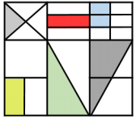
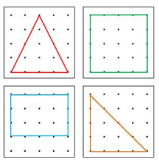
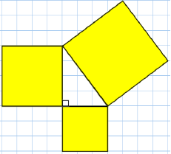
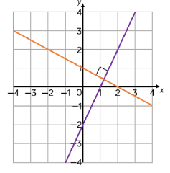
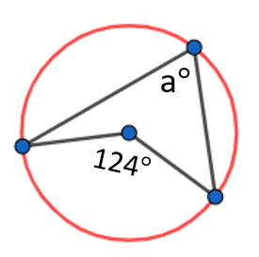
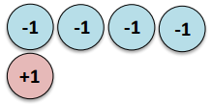
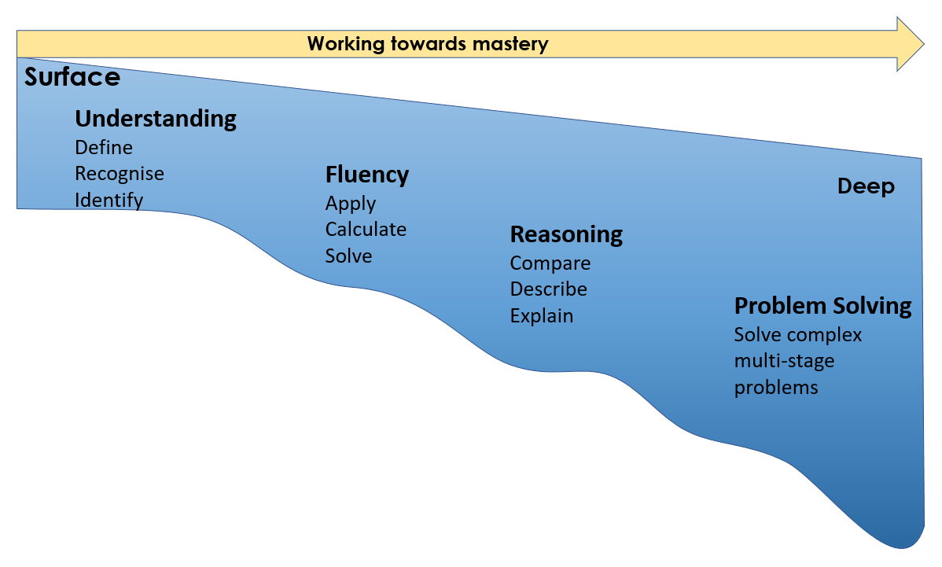
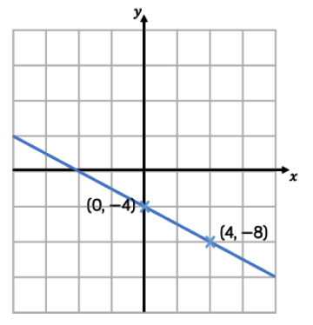
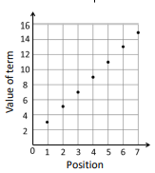
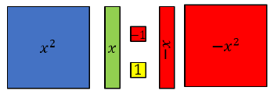
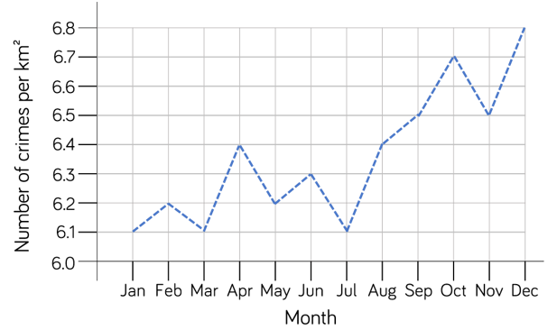
Mathematics Learning Journey
Lines and Angles
Constructing, measuring and using geometric notation
Reasoning with Number
Developing number sense
Sets and probability
Prime numbers and proof
Fractional Thinking
Addition and subtraction with fractions
Reasoning with Proportion
Enlargement and similarity
Solving ratio and proportion problems
Rates
Revision and Communication
Transforming and constructing
Listing and describing
Show that…
Reasoning with Geometry
Deduction
Rotation and Translation
Pythagoras’ Theorem
Algebraic Thinking
Sequences
Understand and use algebraic notation
Equality and equivalence
Representations
Solving problems using graphs, tables and algebra
Reasoning with Number
Numbers
Using percentages
Maths and money
Examinations
8
10
Directed Number
Four operations with directed number
Reasoning
Multiplicative
Geometric
Algebraic
Proportional Reasoning
Ratio and scale
Multiplicative change
Multiplying and dividing fractions
Constructing in 2 and 3 Dimensions
Three dimensional shapes
Constructions and congruency
Similarity
Congruence, similarity and enlargement
Trigonometry
Place Value and Proportion
Place value
Ordering integers and decimals
Fraction, decimal and percentage equivalence
Algebra
Expanding and factorising
Changing the subject
Functions
Further Maths
A Level Maths
Core Maths
Representations
Working in the cartesian plane
Representing Data
Tables and Probability
Developing Algebra
Representing solutions of equations and inequalities
Simultaneous equations
Application of Number
Solving problems with addition and subtraction
Multiplication and division
Fractions and decimals of amounts
Reasoning with Algebra
Straight line graphs
Forming and solving equations
Testing conjectures
Graphs
Gradients and lines
Non-linear graphs
Using graphs
7
9
Geometry
Angles and bearings
Working with circles
Vectors
11
Algebraic Techniques
Brackets, equations and inequalities
Sequences
Indices
Using Number
Non-calculator methods
Types of number sequences
Indices and roots
Proportions and Proportional Change
Ratio and fractions
Percentages and interest
Probability
Developing Number
Fractions and percentages
Standard index form
Number sense
Delving into Data
Collecting, representing and interpreting data
Developing Geometry
Angles in parallel lines and polygons
Area of trapezia and circles
Line symmetry and reflection
Reasoning with Data
The data handling cycle
Measures of location

