Slide 1
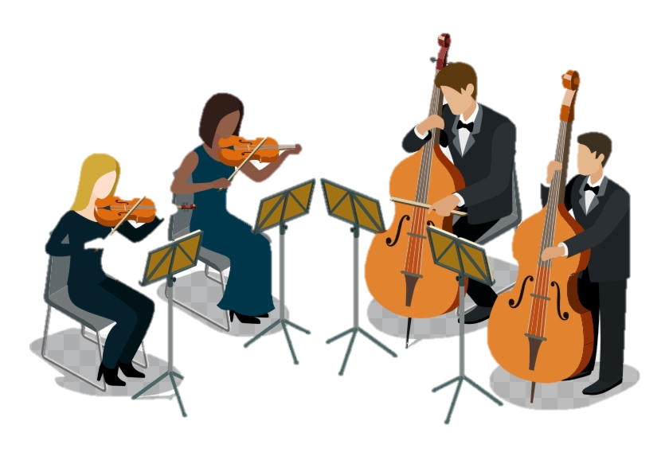
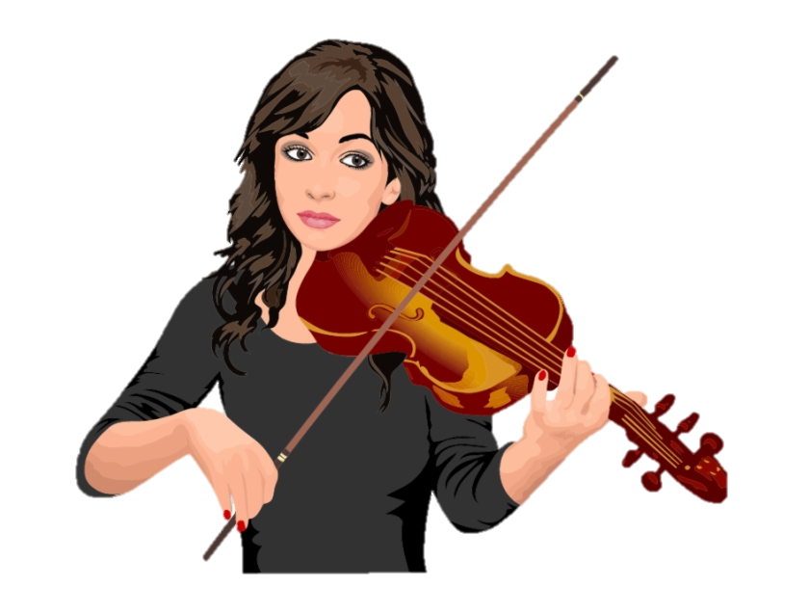
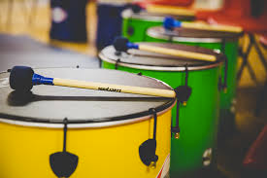
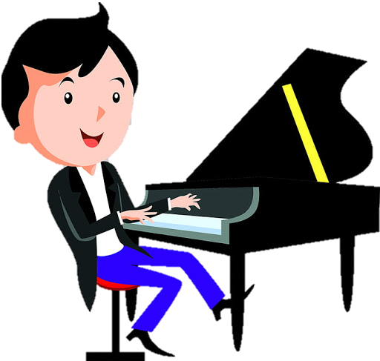
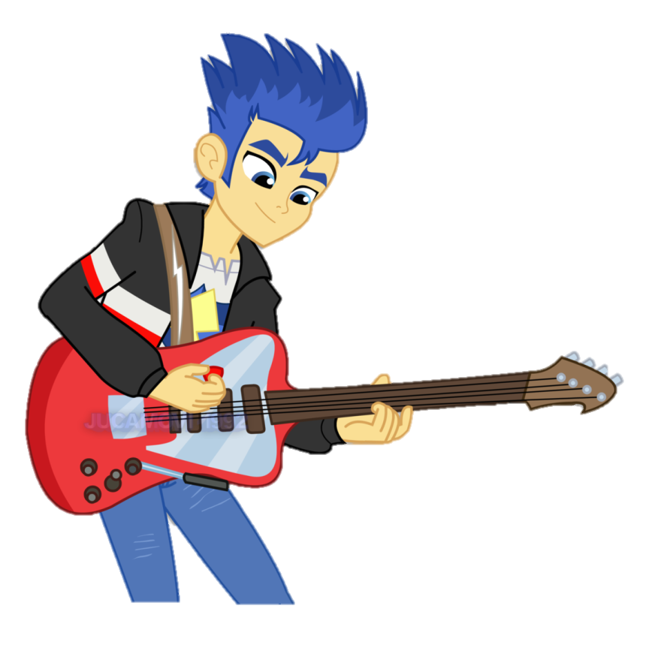
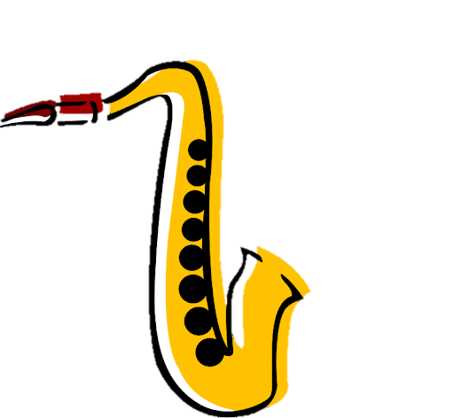
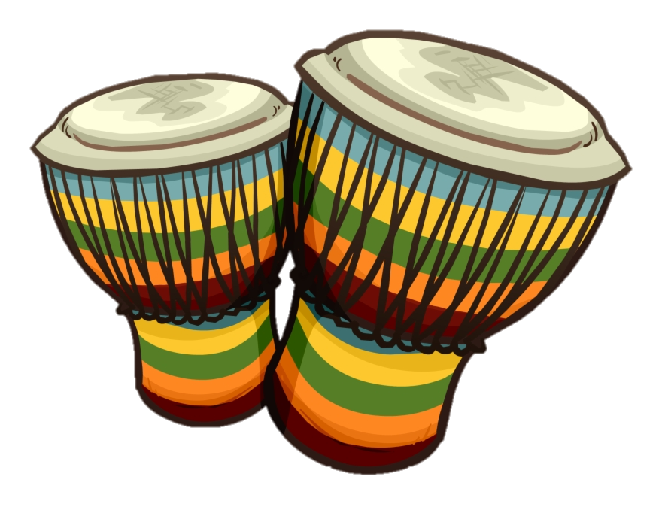
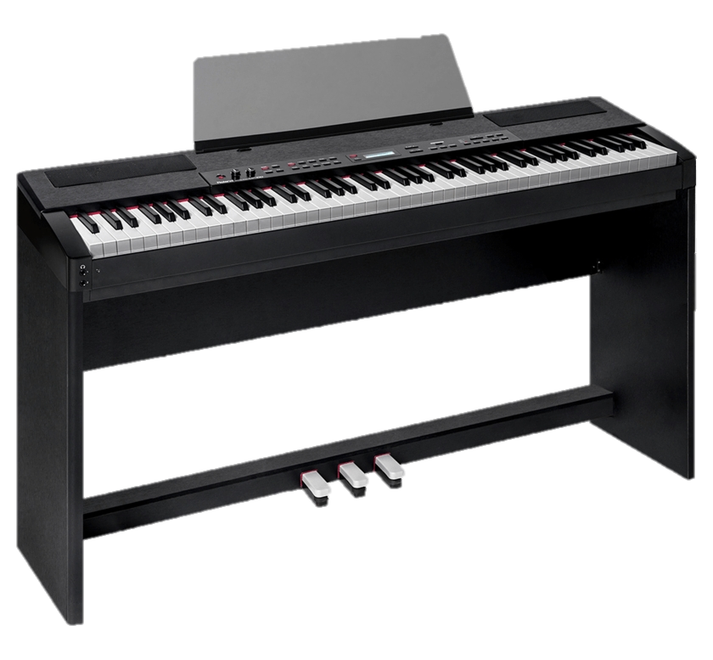
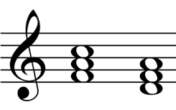
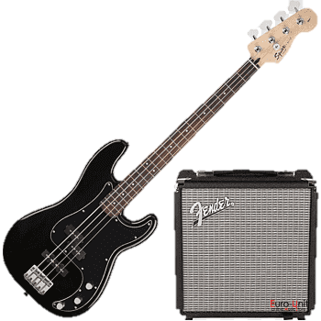
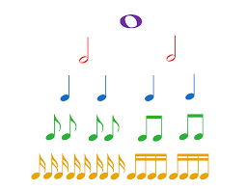
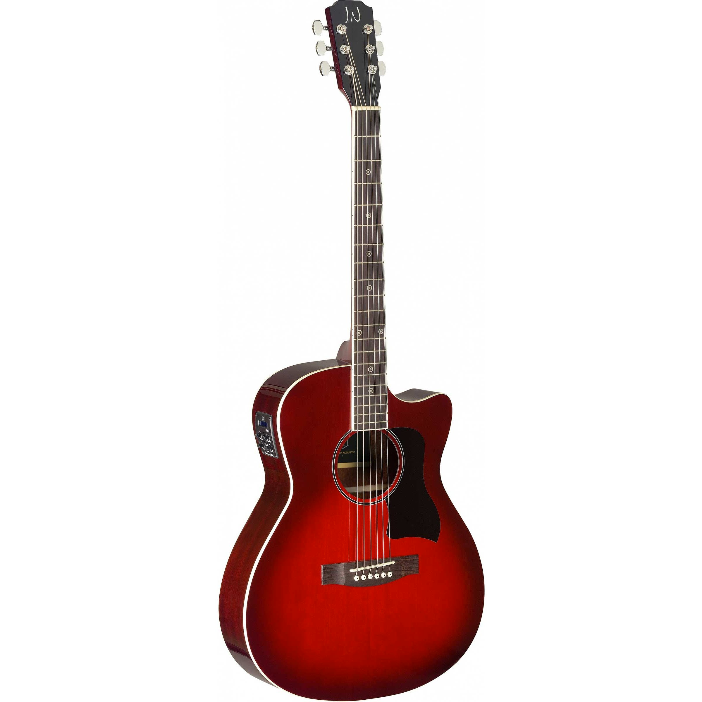
Our Music Learning Journey
Higher Education
Musical knowledge
A core assignment where you explore 2 genres in detail, considering social, musical impacts.
Instrumental Study
Finalise your instrumental study project, presenting your progress in an appropriate format.
Solo / Ensemble Performance Recordings
Solo and ensemble performances will be completed and recorded for coursework
External assessment
10-15 min performance based on the given brief
Musical Knowledge
Research
Provisional research project and information sift on Genres of music.
Instrumental study
Looking at how you develop your instrumental ability through use of technique, planning, H&S and practice regimes
Employment
Stage Setup
Requirements for setting up your performance space, speaker, monitor micro placement
Using A DAW
Developing your knowledge of this area of study and home recording setups
Sound Recording
Developing your knowledge of this area of study and the various ways we can record sound
Health & Safety
Developing your knowledge of this area of study
Conventions of Rock
Developing your knowledge of this area of study
RSL Set Brief
Exploring the RSL assessment brief. How to approach the planning and performance requirements
11
Ensemble Performance
Start working on your performance and rehearsing the material you want to perform with others
Listening & Appraising Music
Throughout year 10 we learn about the music theory that will help you complete your coursework modules
Stagecraft
Learning about how we can project our persona and deliver engaging performances
Conventions of Pop
Developing your knowledge of this area of study
Popular Music
For this topic you will focus on Popular Music, developing your understanding of this genre (linking with Rock School Project).
You will develop an understanding of how a popular song is structured, instruments used and themes the songs focus on.
Samba
This topic introduces you to the polyrhythmic style of Latin American Samba and identifies its roots in African and Spanish/Portuguese music. Understanding the importance of a steady beat/pulse as a foundation of rhythmic music, looping rhythms, polyrhythms, call and response and improvisation.
10
Rock School Project
You will work with musicians from Rockschool Music on an original composition over a period of four visits to school. Experience being part of a band, learning a new instrument/developing their skills on their instrument and building confidence to perform in front of others
Song Writing
Using the skills and knowledge you have acquired so far, put them to use in composing and performing your own songs or instrumental music.
Performing Skills for RSL Music
Introducing RSL performance skills and starting two years of developing solo and ensemble pieces
Soundtracks
You will experience being “film soundtrack composers” and explore the challenges and music devices used in film soundtrack composition.
World Music
Explore the main rhythmic musical features and devices used in African and indian Music, particularly the African drumming tradition of West Africa and the ragas of indian.
9
BBC 10 pieces Gershwin
Explore the great composer George Gershwin and his influence on modern music. Developing skills in rhythm, dexterity and complex melodies.
Variations
Developing the ability to recognise, explore and apply the elements of music to create a musical variation.
Ground bass, melody & harmony, counter melody, theme
Feeling the Blues
Develop an understanding of bass lines and chords as a harmonic foundation upon which a melody can be constructed upon and as a foundation for improvisation.
12 bar blues, developing keyboard skills, melody and chords, improvisation
Reggae & Ska
Explore the music of reggae and ska, focusing on syncopation and off beats. Performing increasingly more complex bass lines.
Song Arranging
The 2nd band and ensemble project in KS3. Expand your group and individual skills arranging music choosing from various genres.
Classical Structure
Explore the great composer use of structure in music. How to compose and perform within given structures and how this if reflected in contemporary music.
8
Classical Moods
Discover how the great composer used various techniques to convey emotion and use music to paint musical pictures of events.
Performing Skills
Develop your knowledge of the Keyboard. Learning how to navigate their way around the keyboard and understanding the functions.
Knowledge of keyboard playing, solo/paired performance skills
Music Technology
Develop your knowledge of the use of music technology in society. How to create EDM through a variety of platforms both in Live contexts and fixed compositions.
Composing
Learn as you play on the Ukulele, Guitar and Keyboard. You’ll work within instrumental groups which rotate, allowing you to experience playing each instrument. Developing an understanding of the instruments and how to produce an effective sound from them
7
Minimalism
Using your elements knowledge and skills you will explore how composers use them in existing music and how you can use them to make your own.
Elements
You will begin to develop your own feeling for and awareness of a regular pulse. You will be able to make a clear distinction between pulse and rhythm. You will develop awareness of Timbre, Dynamics and Tempo.

